Slide 1

WEEKLY UPDATE
Sowmiya Murugiah
50485124

Slide 2


Agenda
Introduction
Docker Configuration
Data Collection
Preprocessing
Inference
Database
Node specific python code
Added requirement.txt
Docker Desktop
Running docker build
Checking docker images
Running docker container
Further Inputs

Slide 3


Introduction
Created Docker images for each operational node. Each node corresponds to a specific process within the application, ensuring a modular and well-organized architecture. Accompanying each node is a dedicated Dockerfile, meticulously crafted to encapsulate the necessary dependencies and configurations, promoting consistency across different environments.
Written distinct Python scripts for each node, encapsulating the functionality specific to their respective processes.
To streamline the orchestration of these Docker containers, I composed a YAML file that delineates the interconnections and configurations of the various nodes. This ensures a cohesive deployment and execution environment for the entire system.

Slide 4
Docker Configuration
Created Docker Images
Utilizing Docker, images were crafted for each distinct node within the system:
Data Collection Node (Dockerfile): Responsible for gathering device details using the psutil library.
Preprocessing Node (Dockerfile): Enabling the preprocessing of raw data, utilizing pandas for data manipulation.
Inference Node (Dockerfile): Designed for running inference on preprocessed data, accommodating the unique logic of the inference module.
Database Node (PostgreSQL) (Dockerfile): Setting up a PostgreSQL database for efficient data storage.

Slide 5

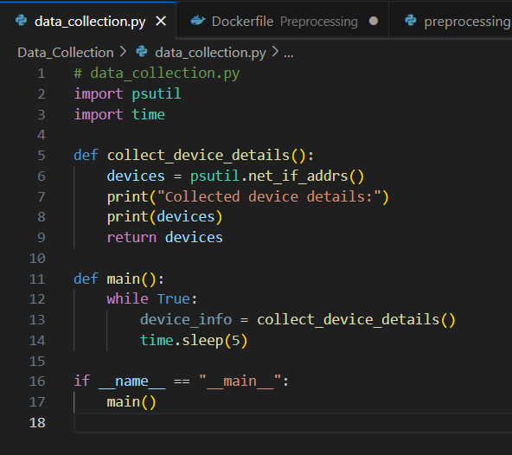
Node-specific Python Code
Data Collection
The data_collection.py script employs the psutil library to collect device details and continuously updates the information in real-time.

Slide 6
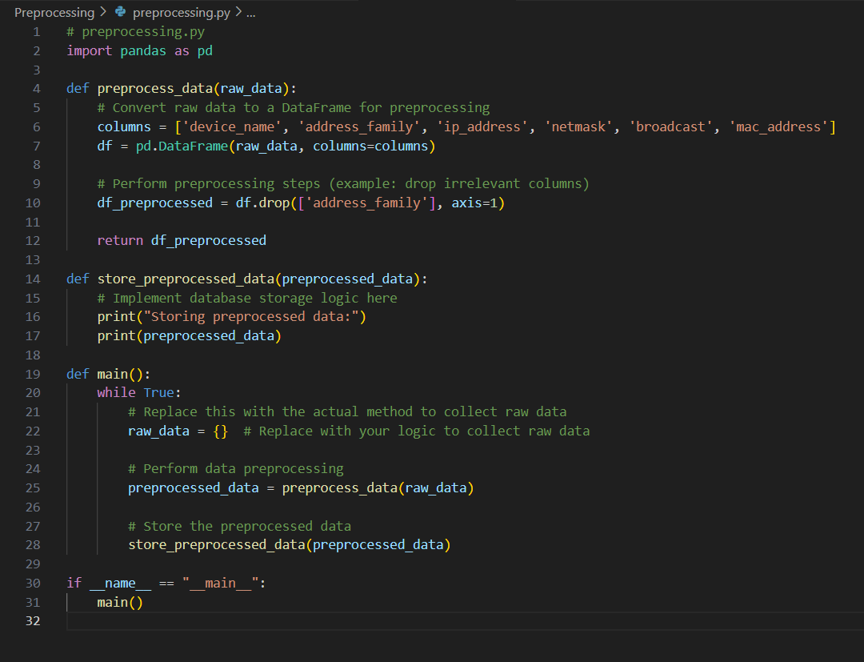
Node-specific Python Code
Preprocessing
The preprocessing.py script processes raw data collected by the Data Collection Node, utilizing pandas for data manipulation and selectively retaining relevant information.

Slide 7
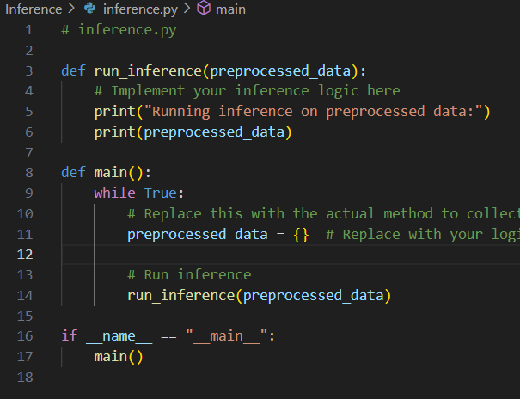
Node-specific Python Code
Inference
The inference.py script is dedicated to running inference on preprocessed data, providing a flexible environment for deploying custom machine learning models or algorithms.

Slide 8
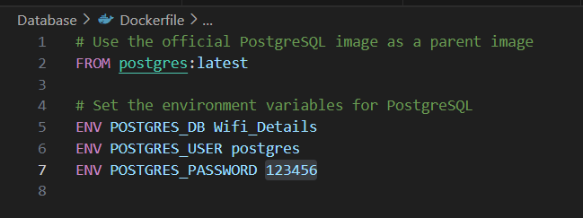
Node-specific Python Code
Database
The Dockerfile_postgres and the associated Python code for interacting with the PostgreSQL database are essential components for efficient data management.

Slide 9
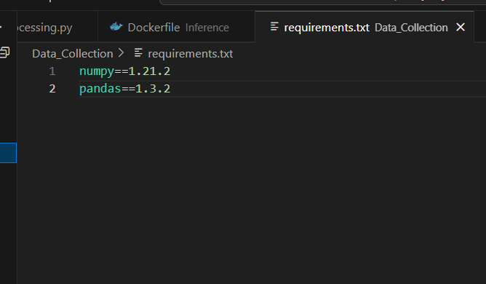
Added requirement.txt
In order to debug python file, added requirements.txt file containing numpy and pandas version
The requirements.txt file is commonly used to list all the Python packages along with their versions that the project depends on. This is beneficial for reproducibility, as it ensures that the project uses specific versions of libraries, minimizing potential compatibility issues.

Slide 10
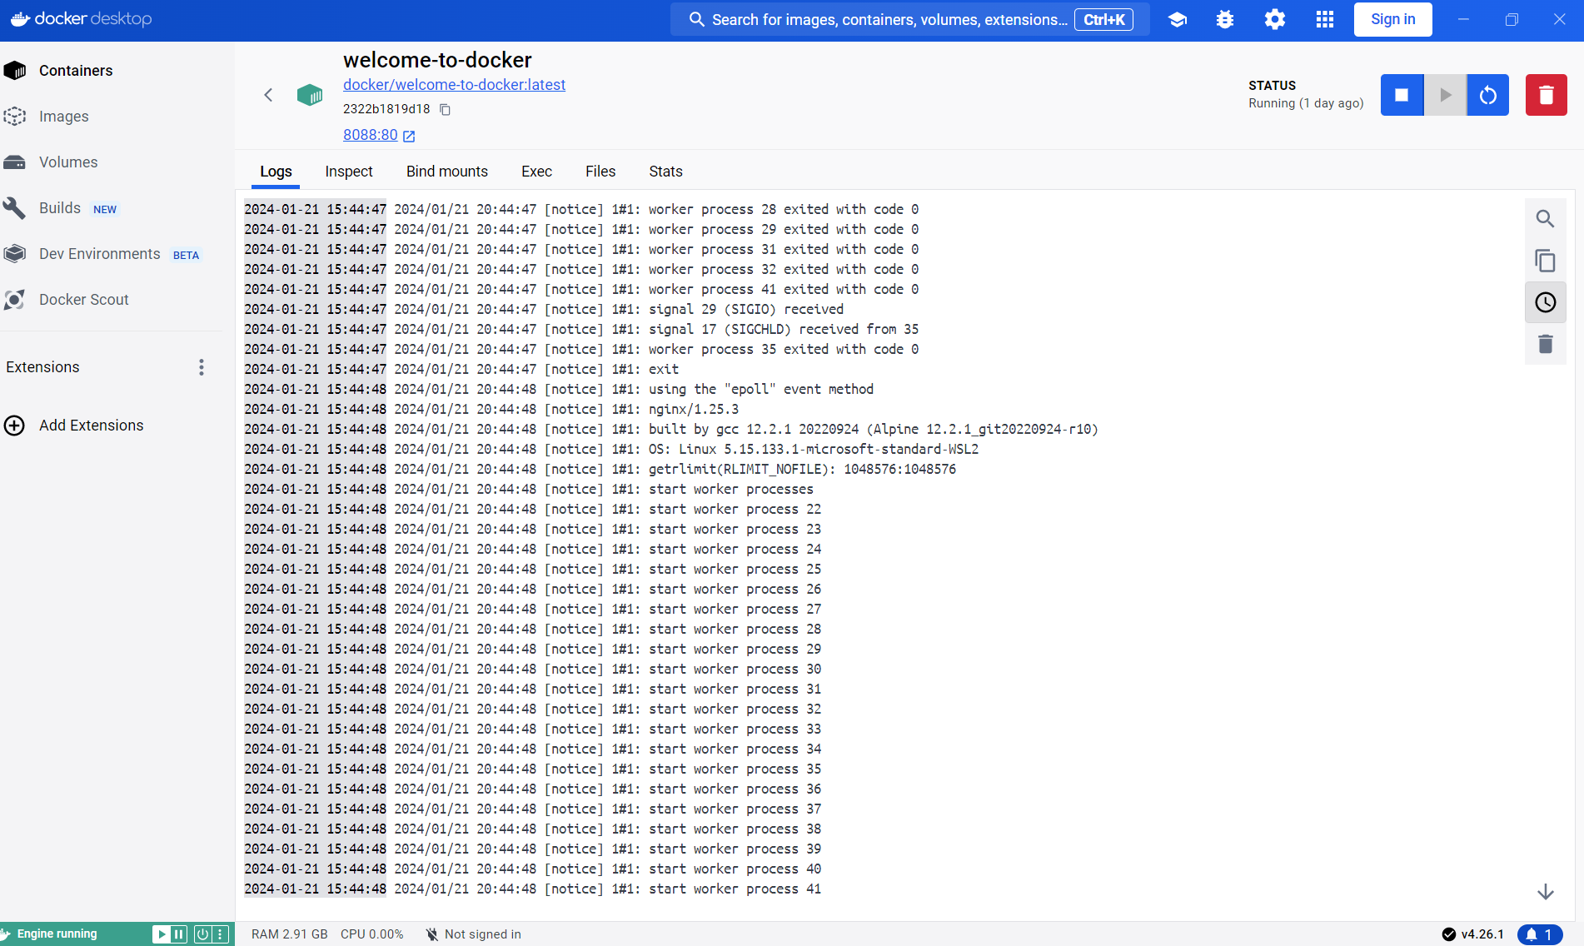
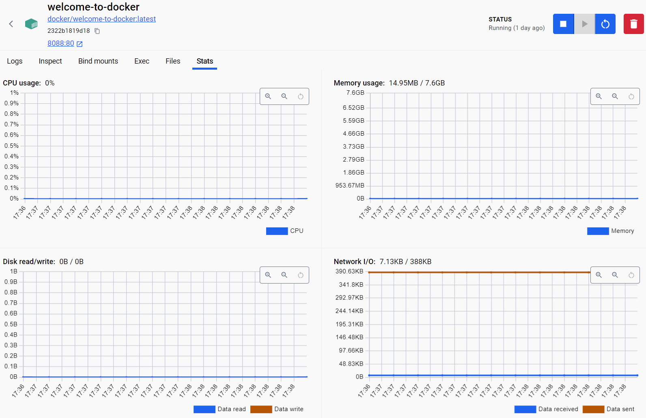
DOCKER DESKTOP
Running docker desktop

Slide 11
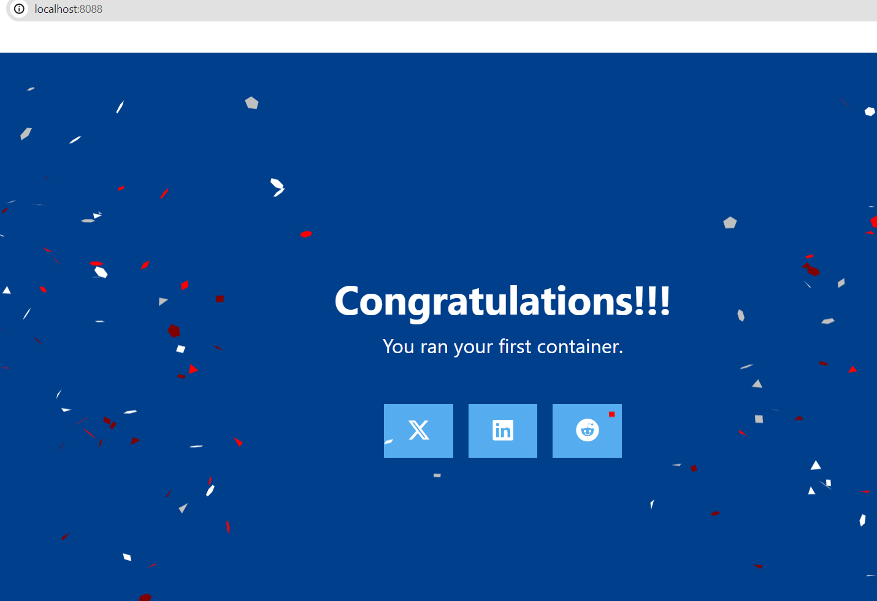
DOCKER DESKTOP
Running docker desktop

Slide 12


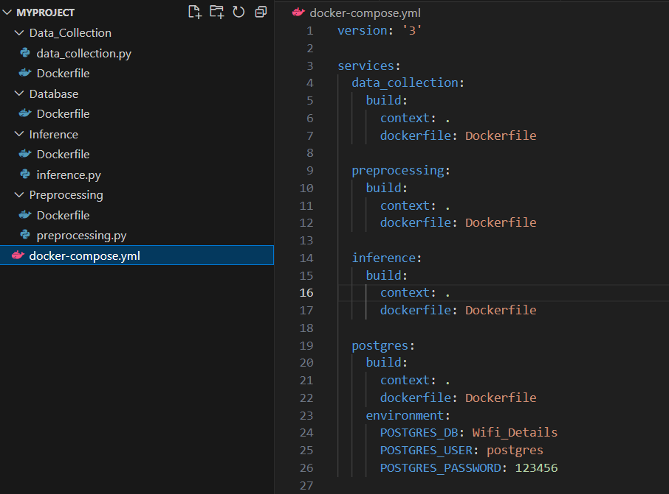

Docker container
Folder structure for the project and docker-compose.yml

Slide 13
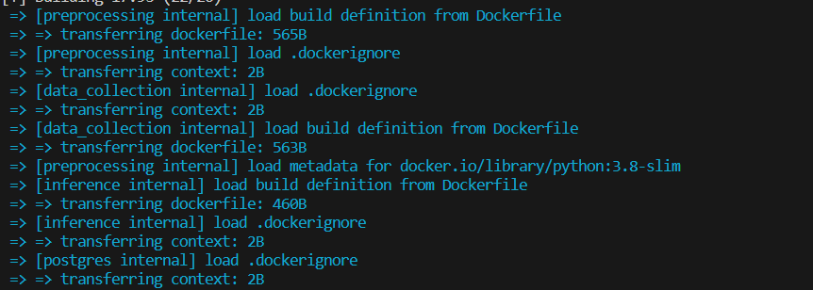
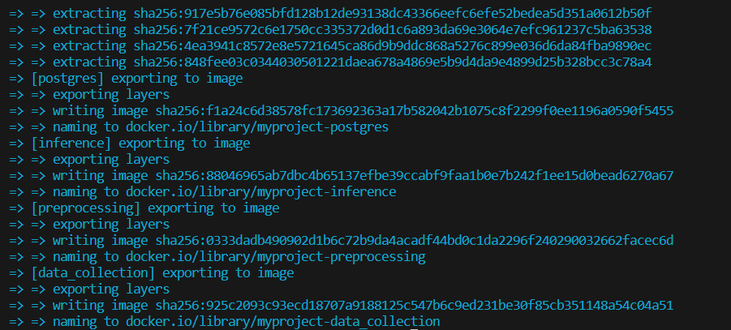
Running docker build command
Command to execute docker build
docker-compose build
This command is used to build Docker
images based on the configurations
defined in the docker-compose.yml file

Slide 14
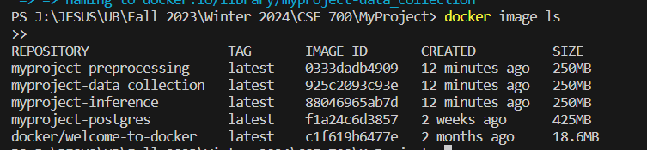
Docker images
After running the docker build if it is
successful then, can view the list of built
Docker images.The below command is
used to see all docker images
Docker image ls

Slide 15
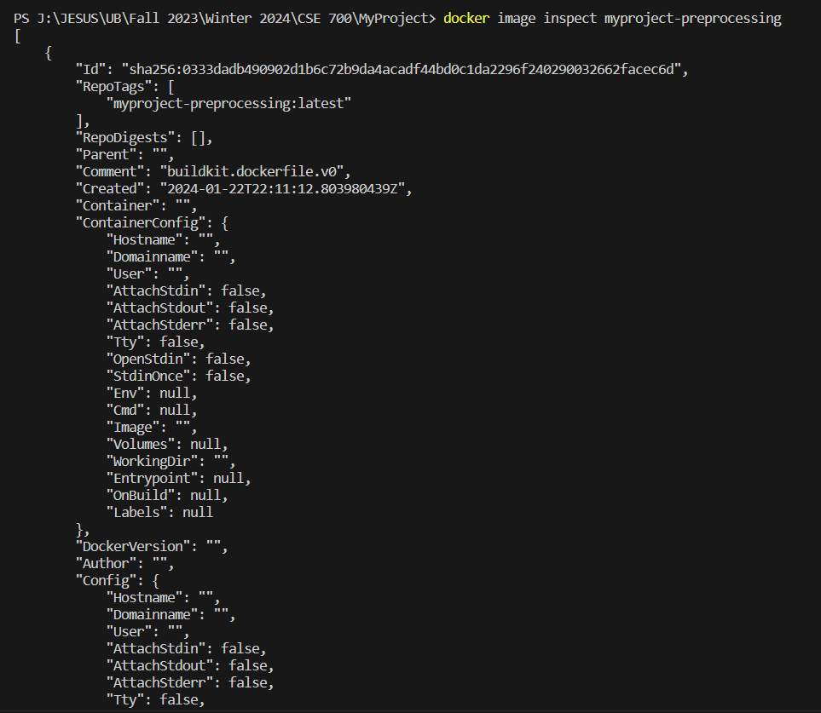
Docker images
In order to inspect specific images
we can use the below commands
Docker image inspect IMAGE_NAME
Eg: Docker image inspect
myproject-preprocessing

Slide 16
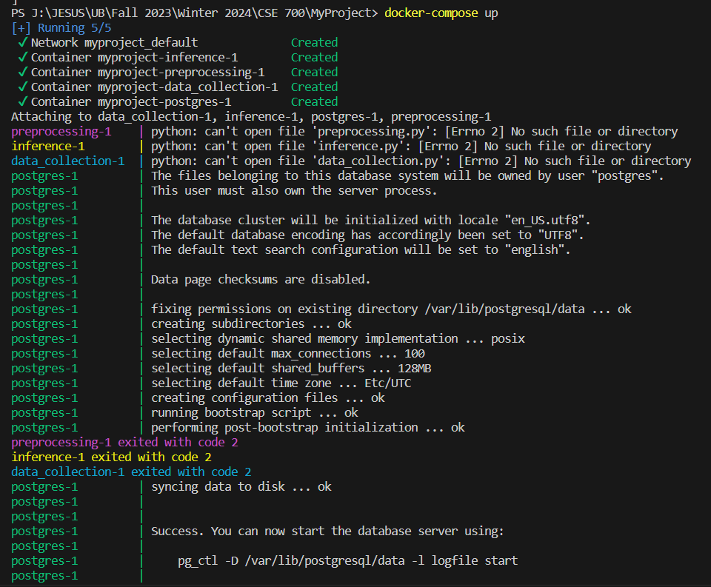
Run docker containers
Docker-compose up
This command will start containers for each service defined in the docker-compose.yml file. If the images have not been built yet, docker-compose up will also build them before starting the containers.

Slide 17




Further inputs
Preprocessing Node
As we progress further, it would be immensely beneficial to receive guidance on the specific preprocessing functionalities deemed crucial for refining the raw data. Understanding the intricacies of the required preprocessing steps will enable to tailor the data collection process more effectively, aligning it with the desired outcome. Your insights into the necessary preprocessing functionalities would greatly influence the development of this module. Clarity on the specific preprocessing steps, transformations, or manipulations expected in the pipeline would be instrumental in shaping this crucial stage of data refinement.
Inference Node
In this context, understanding the preferred machine learning algorithms or methodologies that should be implemented is paramount. Your guidance on the specific ML algorithms or approaches deemed suitable for the inference stage would significantly influence the design and implementation decisions within this node.
THANK YOU

